Slide 1

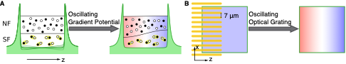
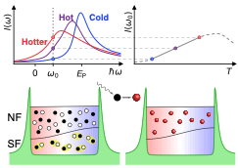
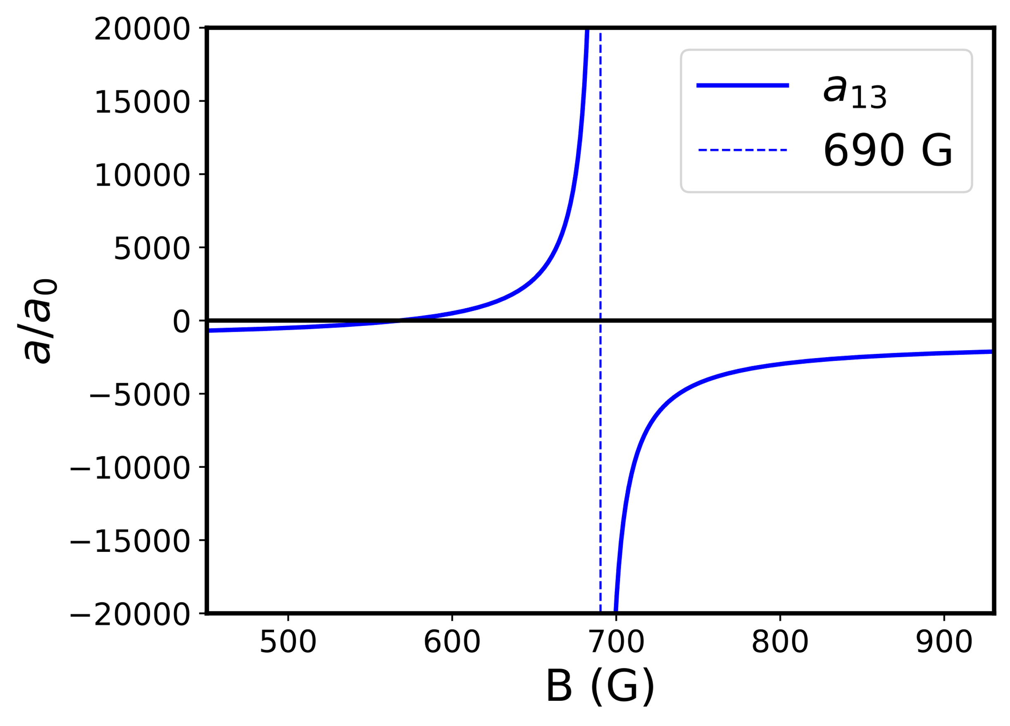
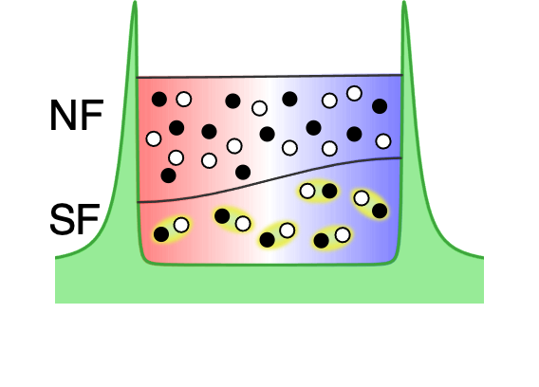
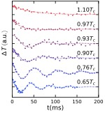
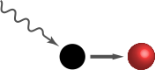
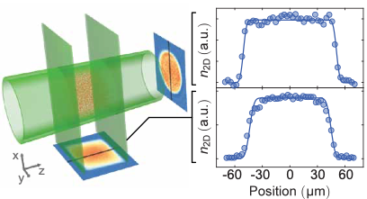
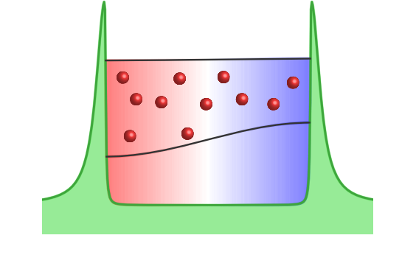
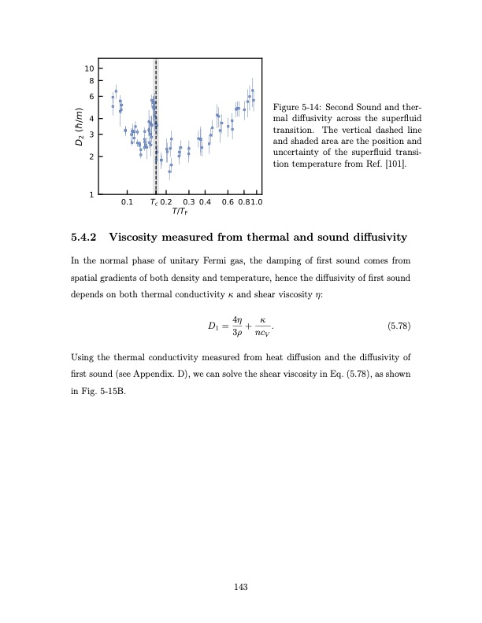
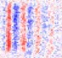
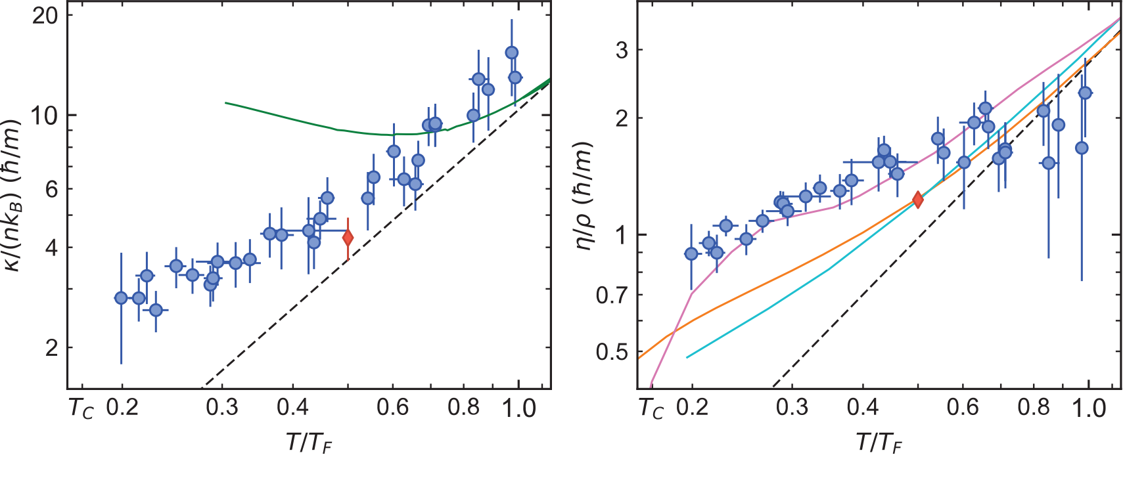
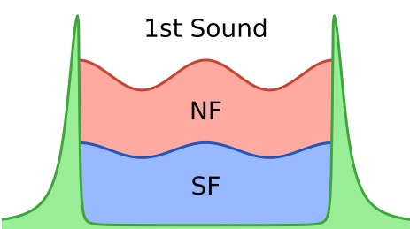
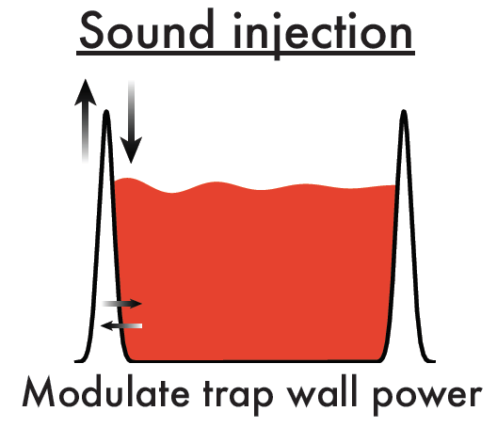
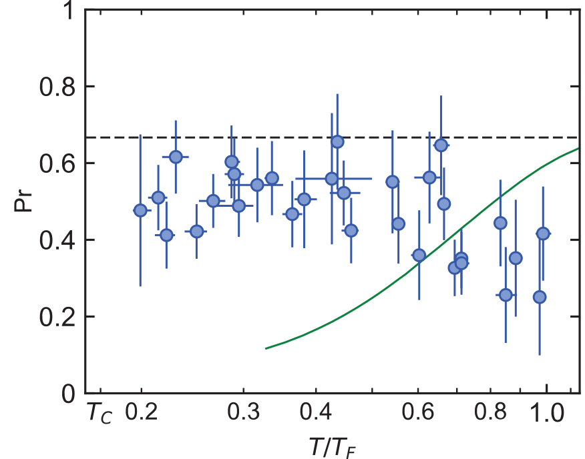
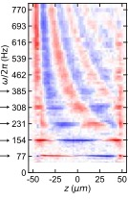
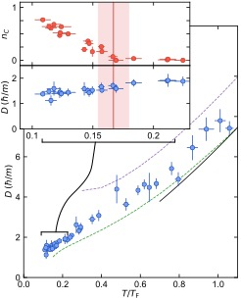
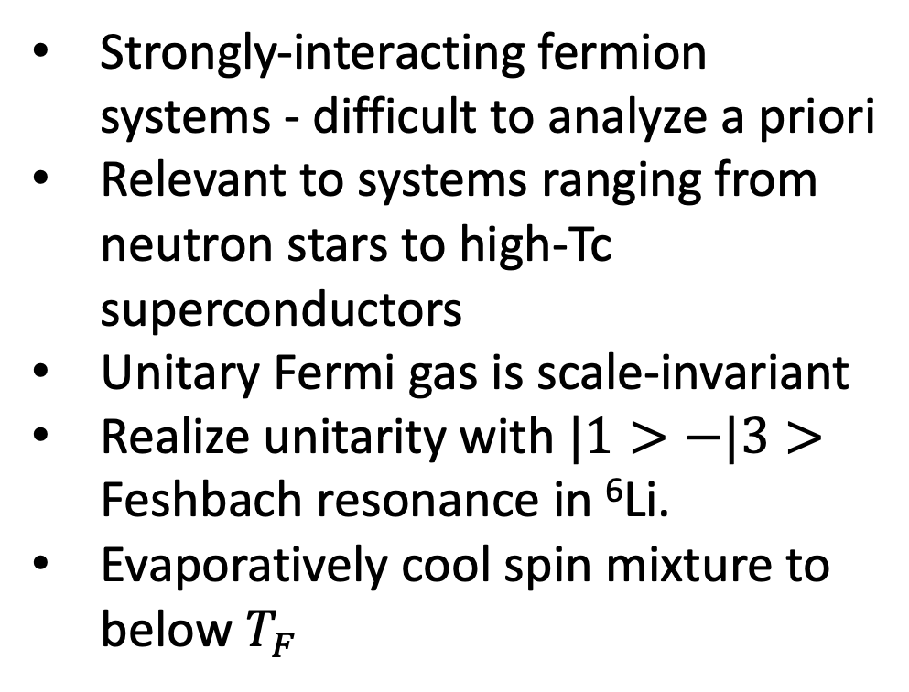
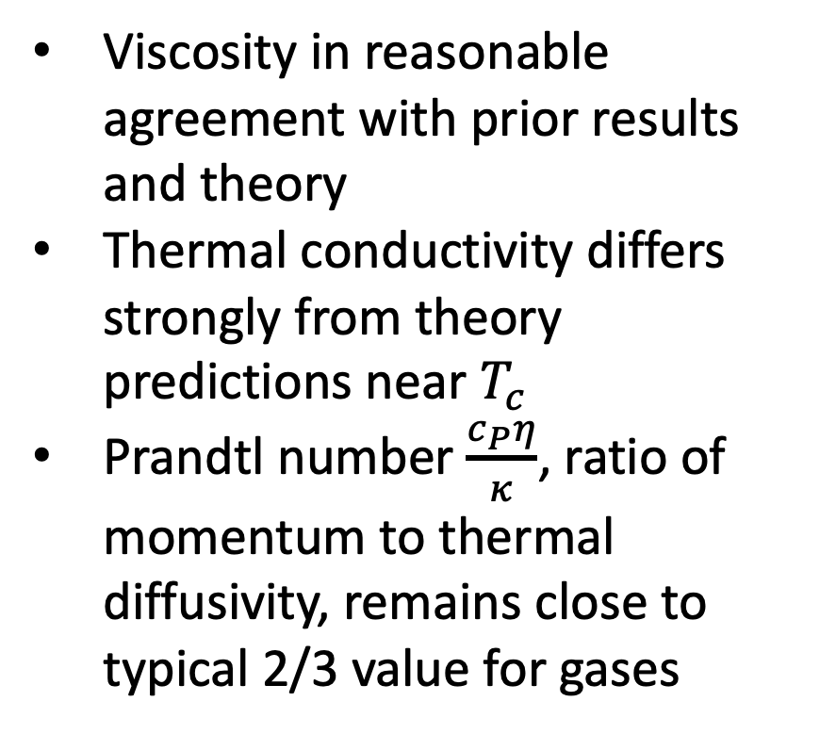

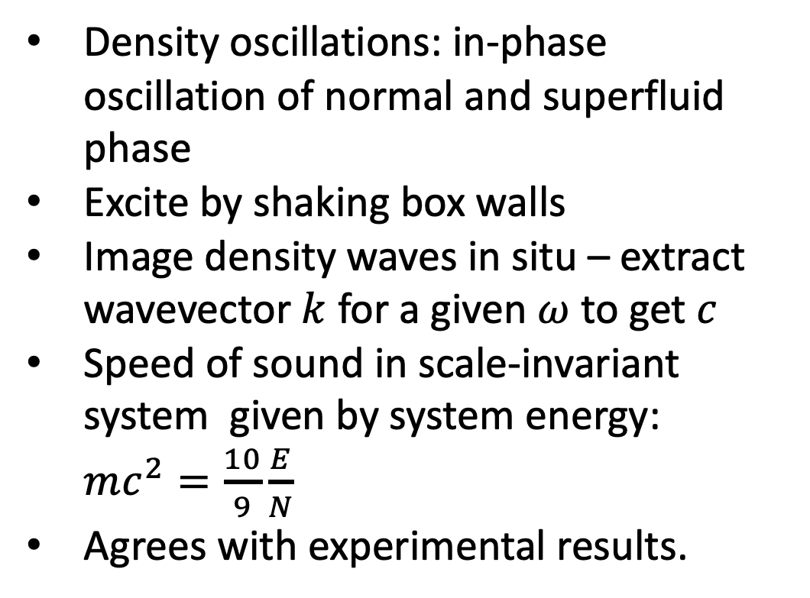
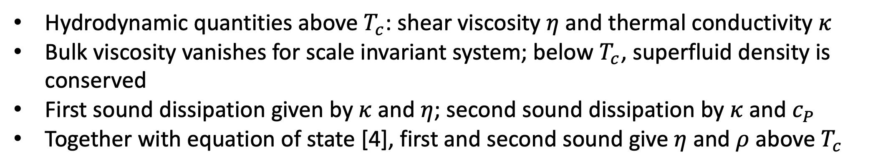
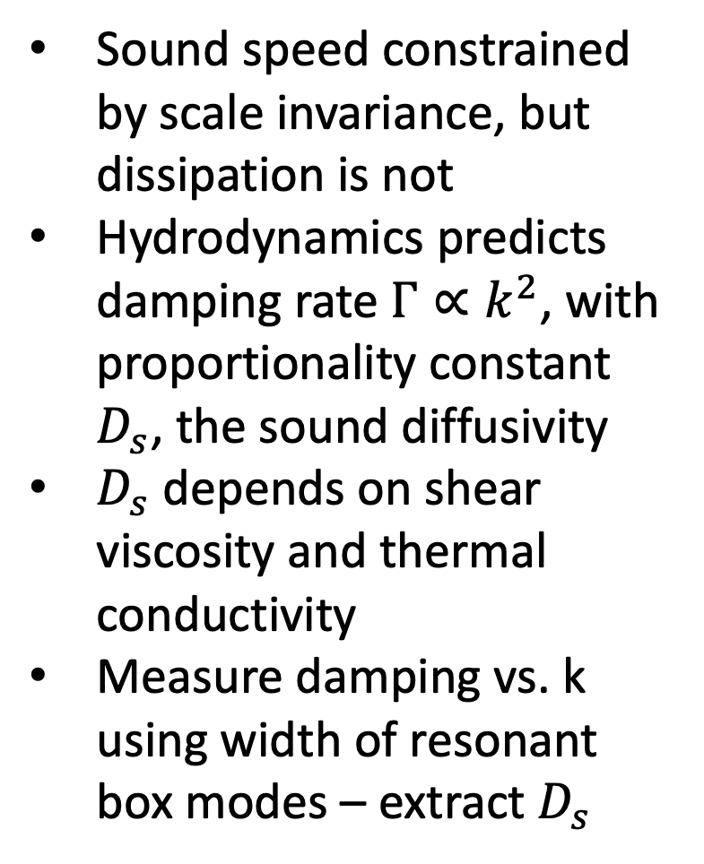

Hydrodynamic Properties of the Unitary Fermi Gas
Eric Wolf, Huan Q Bui, Parth B Patel, Zhenjie Yan, Carsten Robens, Richard Fletcher, Martin Zwierlein
MIT-Harvard Center for Ultracold Atoms, Research Laboratory of Electronics, Massachusetts Institute of Technology, Cambridge, MA 02139
Unitary Fermi Gas in a Box Potential
Temperature Response –Second Sound [3]
Unitary Fermi Gas
Second Sound
Strongly-interacting fermion systems - difficult to analyze a priori
Relevant to systems ranging from neutron stars to high-Tc superconductors
Unitary Fermi gas is scale-invariant
Realize unitarity with $|1>−|3>$ Feshbach resonance in ⁶Li.
Evaporatively cool spin mixture to below $T_{F}$
Temperature oscillations: out-of-phase oscillations of normal and superfluid phase
Excite oscillations by driving high-frequency sound waves to locally heat the gas
Measure temperature locally using RF spectroscopy
Second sound is only present below the superfluid transition temperature
Damping rate of second sound gives thermal conductivity
Box Potential [1]
Hollow blue-detuned beams realize (quasi) flat potential
Reduces influence of trap averaging & targets smaller range of densities
Residual harmonic trap in axial dimension allows momentum-space imaging
Density Response – First Sound [2]
Hydrodynamics – Transport Properties
First Sound
Hydrodynamic Quantities
Density oscillations: in-phase oscillation of normal and superfluid phase
Excite by shaking box walls
Image density waves in situ – extract wavevector $k$ for a given $ω$ to get $c$
Speed of sound in scale-invariant system given by system energy: $mc^{2}=\frac{10}{9}\frac{E}{N}$
Agrees with experimental results.
$$−$$
$$=$$
Hydrodynamic quantities above $T_{c}$: shear viscosity $η$ and thermal conductivity $κ$
Bulk viscosity vanishes for scale invariant system; below $T_{c}$, superfluid density is conserved
First sound dissipation given by $κ$ and $η$; second sound dissipation by $κ$ and $c_{P}$
Together with equation of state [4], first and second sound give $η$ and $ρ$ above $T_{c}$
Resonant Modes and Dissipation
Results
Sound speed constrained by scale invariance, but dissipation is not
Hydrodynamics predicts damping rate $Γ∝k^{2}$, with proportionality constant $D_{s}$, the sound diffusivity
$D_{s}$ depends on shear viscosity and thermal conductivity
Measure damping vs. k using width of resonant box modes – extract $D_{s}$
Viscosity in reasonable agreement with prior results and theory
Thermal conductivity differs strongly from theory predictions near $T_{c}$
Prandtl number $\frac{c_{P}η}{κ}$, ratio of momentum to thermal diffusivity, remains close to typical 2/3 value for gases
Red diamond [5], green line [6], pink line [7], cyan line [8], orange line [9]
References
[5] L. Baird et al., PRL 2019
[6] B. Frank et al., Phys Rev Research 2020
[7] J. A. Joseph et al., PRL 2015
[8] M. Bluhm et al., PRL 2017
[9] T. Enss et al., Annals of Physics 2011
Funding
[1] B. Mukherjee et al., PRL 2017
[2] P.B. Patel et al., Science 2020
[3] Z. Yan et al., in preparation
[4] M.J.H. Ku et al., Science 2012

